Slide 1






FAKE NEWS DETECTION
P Nageswararao(20MIS1006)
Ch Jaya Venkatesh(20MIS1083)
M Srikanth(20MIS1086)

Slide 2



ABSTRACT
Fake news, often spread across the internet with sensationalist headlines, aims to manipulate readers’ perceptions and damage individuals, organizations, or agencies. Detecting fake news is crucial, and researchers globally are exploring computational methods to address this challenge. This study proposes a methodology for detecting fake news using regression and ensemble learning algorithms, including Random Forest, Decision Tree, and Gradient Boosting.

Slide 3
INTRODUCTION
The proliferation of fake news has become a significant issue, shaping people’s views through various channels such as websites, social media, and articles. Social media platforms like Twitter and Facebook facilitate the rapid diffusion of incorrect content. MIT scholars found that fake news stories on Twitter are 70% more likely to be retweeted than true stories. Detecting fake news is challenging due to eye-catching titles and clickbait, which prevent critical verification. An automated tool that filters inaccurate information could save time, effort, and build trust among readers1

Slide 4
METHODOLOGIES
Preprocessing:
Before feeding the text data into machine learning models, we need to preprocess it.
Common preprocessing steps include:
Tokenization: Splitting the text into individual words or tokens.
Lowercasing: Converting all text to lowercase to ensure consistency.
Removing Stop Words: Eliminating common words (e.g., “the,” “and,” “in”) that don’t carry significant meaning.
Stemming or Lemmatization: Reducing words to their root form (e.g., “running” to “run”).
Removing Special Characters and Punctuation: Cleaning up unwanted symbols.
Feature Extraction: Converting text into numerical features (e.g., using TF-IDF or word embeddings).

Slide 5
METHODOLOGIES
Feature Engineering:
Creating relevant features from the preprocessed text is crucial.
Some feature engineering techniques include:
Bag of Words (BoW): Representing text as a vector of word frequencies.
TF-IDF (Term Frequency-Inverse Document Frequency): Assigning weights to words based on their importance in a document.
Word Embeddings (e.g., Word2Vec, GloVe): Capturing semantic relationships between words.
N-grams: Considering sequences of adjacent words (e.g., bigrams, trigrams).
Sentiment Analysis Features: Extracting sentiment scores from the text.

Slide 6
METHODOLOGIES
Decision Trees:
In the context of fake news detection, decision trees create a tree-like structure where each internal node represents a feature or attribute, and each leaf node corresponds to a class label (e.g., “fake” or “real”).
Decision trees split the data based on feature values to make decisions about class labels.
Logistic Regression:
Logistic regression is another supervised learning algorithm commonly used for binary classification tasks.
It models the probability of an instance belonging to a particular class (e.g., “fake” or “real”) based on input features.
Logistic regression uses a sigmoid function to map linear combinations of features into probabilities.

Slide 7
METHODOLOGIES
Ensemble Methods:
Ensemble methods combine multiple models to improve overall performance.
Common ensemble techniques include:
Random Forest (RF):
Constructs multiple decision trees and averages their predictions.
Helps reduce overfitting and provides feature importance.
Gradient Boosting (e.g., XGBoost, LightGBM):
Builds an ensemble of weak learners (usually decision trees) sequentially.
Each new tree corrects the errors made by the previous ones.
Often achieves high accuracy.

Slide 8
METHODOLOGIES
Model Evaluation:
Split the dataset into training and testing subsets.
Evaluate the ensemble models using appropriate metrics:
Accuracy: Overall correctness of predictions.
Precision: Proportion of true positive predictions among all positive predictions.
Recall (Sensitivity): Proportion of true positive predictions among actual positives.
F1 Score: Harmonic mean of precision and recall.
Use cross-validation to assess generalization performance.

Slide 9
PESUDOCODE
def output_lable(n):
if n == 0:
return "Fake News"
elif n == 1:
return "Not A Fake News"
def manual_testing(news):
testing_news = {"text":[news]}
new_def_test = pd.DataFrame(testing_news)
new_def_test["text"] = new_def_test["text"].apply(wordopt)
new_x_test = new_def_test["text"]
new_xv_test = vectorization.transform(new_x_test)
pred_LR = LR.predict(new_xv_test)
pred_DT = DT.predict(new_xv_test)
pred_GBC = GBC.predict(new_xv_test)
pred_RFC = RFC.predict(new_xv_test)
return print("\n\nLR Prediction: {} \nDT Prediction: {} \nGBC Prediction: {} \nRFC Prediction: {}".format(output_lable(pred_LR[0]), output_lable(pred_DT[0]),output_lable(pred_GBC[0]),output_lable(pred_RFC[0])))

Slide 10
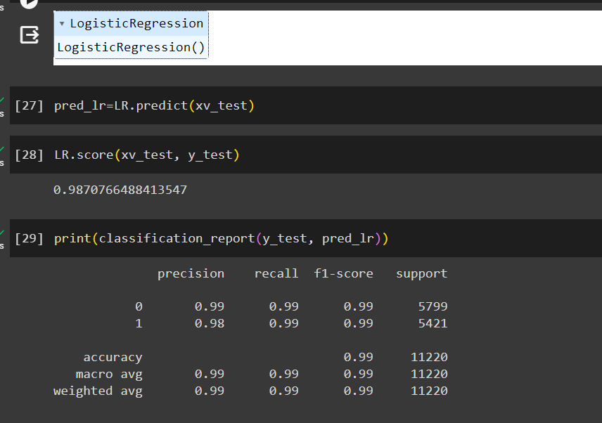
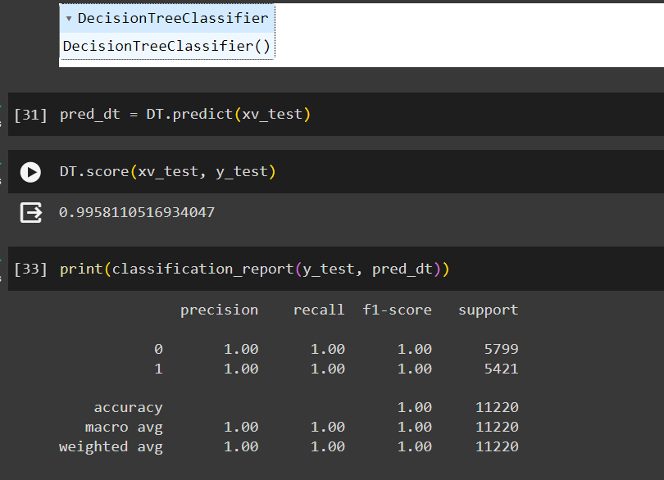
FINAL RESULT - OUTPUT

Slide 11
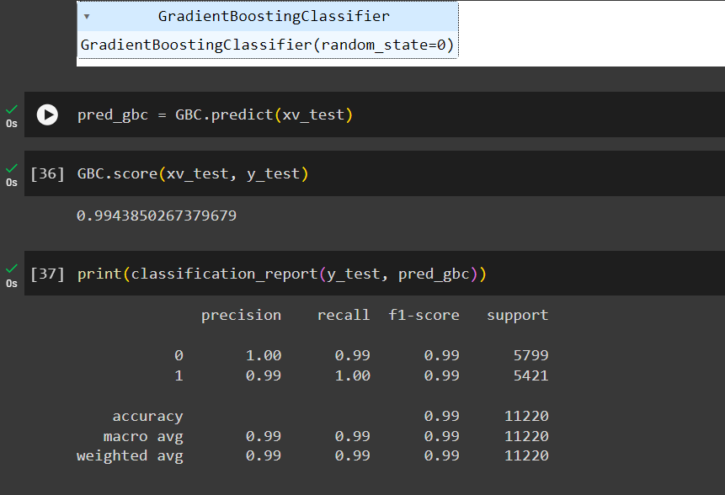
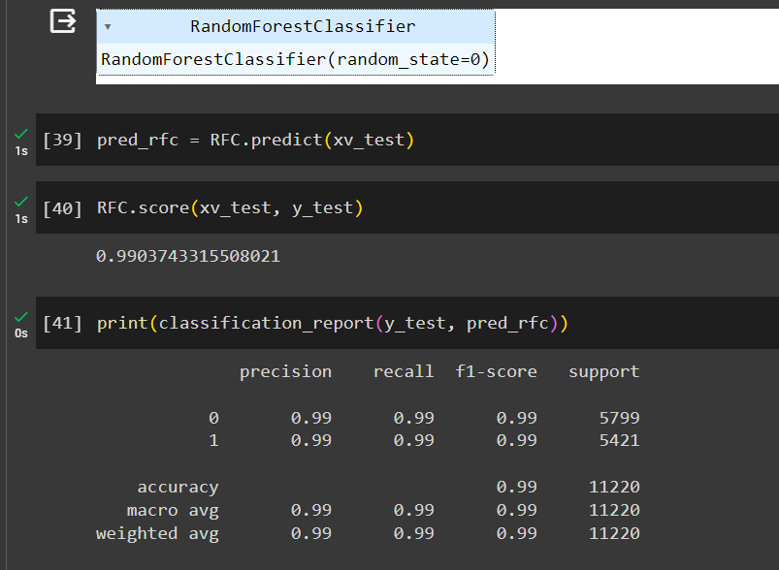
FINAL RESULT - OUTPUT

Slide 12
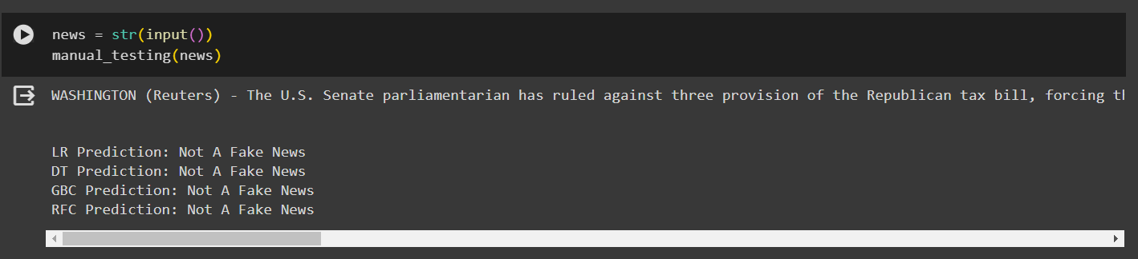
FINAL RESULT - OUTPUT

Slide 13
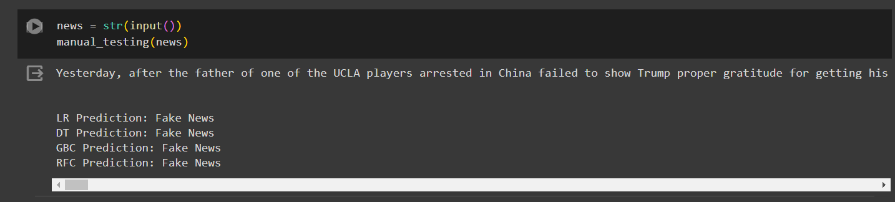
FINAL RESULT - OUTPUT

Slide 14



CONCLUSION
In this study, we explored the application of machine learning ensemble methods for detecting fake news. Our proposed approach leverages the power of ensemble learners, including Random Forest and Gradient Boosting, to classify news articles automatically. By considering various textual properties, we achieved superior performance compared to individual models.
Key Takeaways:
Ensemble Methods Shine: Combining multiple models enhances accuracy and robustness.
Text Preprocessing Matters: Properly preprocess text data to improve model performance.
Evaluation Metrics: Use precision, recall, F1 score, and other relevant metrics to assess model effectiveness.
Ongoing Research: Continued efforts are essential to combat misinformation in the digital age.

Slide 15

THANK YOU

